Slide 1
Dashboard Design
NAME – SUBHASISH PATRO
DATE – 27/06/2025
TOOLS USED - TABLEAU

Slide 2
OBJECTIVE
To visualize and analyze key business metrics like Sales, Profit, and Growth.
Identify trends over time and segment performance using interactive filters.
Provide actionable insights for decision-making.

Slide 3
DATASET OVERVIEW
Source: Sample Superstore dataset.
Records: ~10,000 orders.
Columns include: Order Date, Region, Category, Sales, Product Name, Product ID etc.

Slide 4
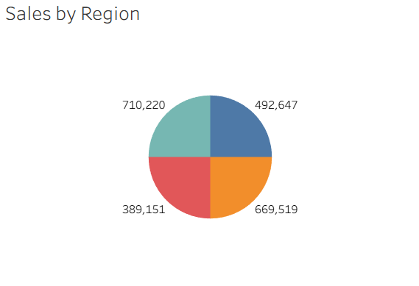
SALES BY REGION
The sales data is divided across four main regions: West, East, Central, and South.
The region with the highest total sales is West, indicating strong customer demand and possibly better marketing or distribution networks in that area.
South has the lowest sales, suggesting the need to investigate customer behavior, pricing, or product availability in that region.
There is a noticeable imbalance in sales across regions, with the top region generating nearly 2x the revenue compared to the lowest one.
Regions like Central, South-East, with moderate performance, could benefit from targeted marketing strategies to boost sales.

Slide 5
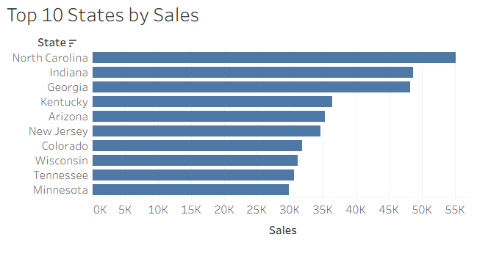
TOP 10 STATES BY SALES
California is the top contributor to overall sales, possibly due to a large market size, urban population, or business presence.
States like New York, Texas, & Washington consistently show strong sales, indicating well-established customer bases.
These top 10 states together contribute approximately 60–70% of total sales, showing high sales concentration in a few areas.
Investing more in these top-performing states (via promotions, inventory, faster delivery, etc.) can yield better ROI.

Slide 6
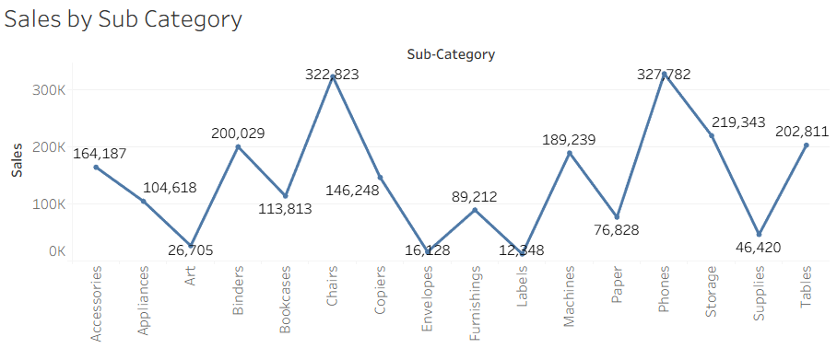
SALES BY SUB CATEGORY
Technology leads in total sales, indicating high product demand and possibly better profit margins.
Furniture generates moderate sales, suggesting stable customer interest but potential for growth with targeted strategies.
Office Supplies shows the least revenue, possibly due to low unit prices or high competition.
Some categories may have high sales but lower profit margins. Always check profitability alongside total sales.
Businesses should focus on promoting high-margin products in top-selling categories and find ways to boost low-performing ones through bundling or discounts.

Slide 7
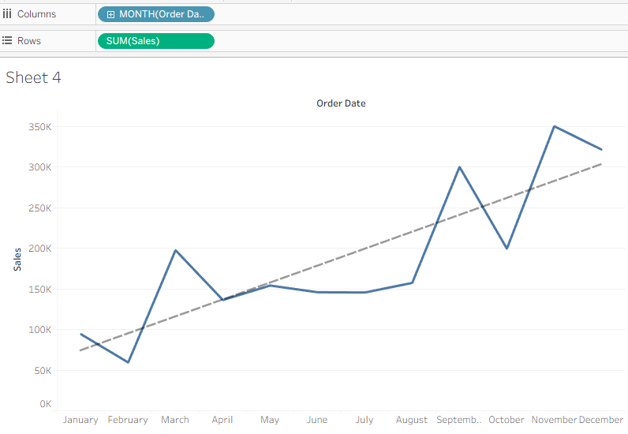
SALES TREND OVER TIME
The X-axis represents the months of the year.
The Y-axis shows the total sales value for each
month.
A trend line has been added to indicate the
overall direction of sales growth.
Sales show fluctuations across different months,
with noticeable peaks around March and September.
The trend line indicates a steady upward movement,
suggesting positive growth over time.
This visualization helps identify seasonal patterns and
high-performing months, which are useful for sales
planning and forecasting

Slide 8
DETAILED ANALYSIS DASHBOARD
The Detailed Analysis Dashboard dives deeper into specific dimensions of the business, such as state-wise, product-wise, and category-wise performance.
INSIGHTS GAINED :
Concentrated sales in specific product categories and states.
Some sub-categories (e.g., Tables) may show high sales but low profit.
Helps in refining marketing strategy, inventory planning, and pricing.
Western region has highest sales but low profit.
Office Supplies shows consistent growth.
Profitability varies by segment and shipping mode.
Interactive Dashboard link :
Sales Dashboard

Slide 9
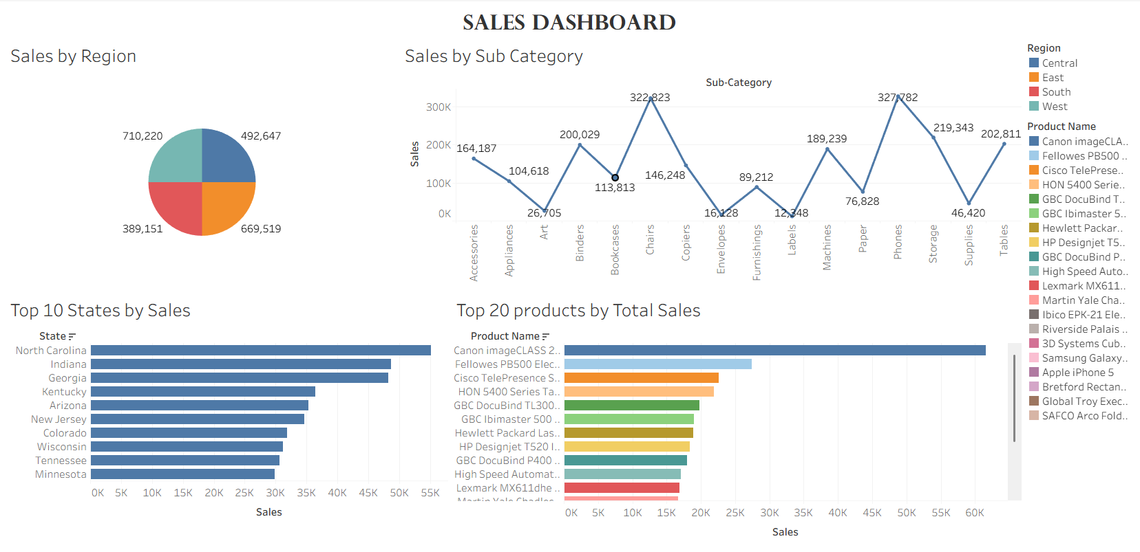
INSIGHTS AND OBSERVATIONS

Slide 10
CONCLUSION
Tableau makes it easy to explore business performance visually.
It helps identify trends, low-performing areas, and future opportunities
THANK YOU

